Slide 1
The Ising Model
Lattice – several points in a set dimension, either
1-D, 2-D, 3-D, etc.
Each point has one of two charges (+/-) or directions (up/down).
Each line between points is called a bond. If there is a bond connecting two points, they are referred to as nearest neighbors.
Notes:
Amanda

Slide 2
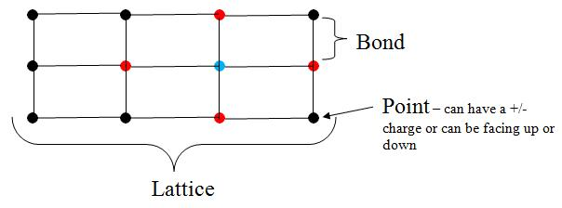
All of the red points are nearest neighbors to the blue point. This is a 2-dimensional lattice
Notes:
Amanda

Slide 3
Hamiltonian Equation
Calculates the total energy of a system
Defined as: H = H(σ) = - ∑ E σ_{i}σ_{j} - ∑Jσ_{i}
<i,j>
i
Where:
H = total energy of the system
σ = the value assigned to a specific lattice site (up/down or +/-)
σ _{i} and σ _{j} = the value of the spin at the specific lattice site, where σ = +1 if the spin is pointing up or σ = -1 if the spin is pointing down
It’s important to understand that for ∑ E σ_{i}σ_{j} , the i and j in brackets (<i , j>) means that
σ _{i}* σ _{j} is added up over all possible nearest neighbor pairs.
Since the second summation is just for i, we can just add up σ _{i} for lattice i.
Values E and J are both constants, where:
E = strength of the σ _{i} and σ _{j} interaction
J = additional interaction of the individual spins with some external magnetic field (i.e temperature)
Notes:
Amanda

Slide 4

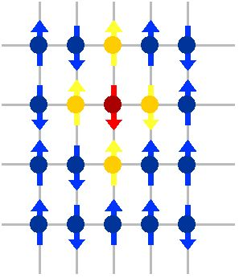





+1
+1
-1
-1
+1
From our simplified Ising Model, we took the E and J parameters out of the summations and set E = 1 and J = 0
Now we can start calculating the Hamiltonian equation:
  First, we need the summation of all the energies of all the nearest neighbor pairs surrounding the chosen lattice site (in red):
-E∑ σ_{i}σ_{j}-J ∑σ_{i} =-(1)[(-1)(+1) + (-1)(+1) + (-1)(+1) + (-1)(-1)] - (0)[-1+-1+-1+-1] = 2
Notes:
Amanda

Slide 5
+1
Now, we should flip the red point to a
positive 1 to see if the total energy
will decrease. If the flip produces a lower
energy, we will keep the flip since
the lattice favors a lower energy.
+1
-1_x0016_
+1
+1
-E∑ σ_{i}σ_{j}-J ∑σ_{i} =-(1)[(1)(1) + (1)(1) + (1)(1) + (1)(-1)] - (0)[1+1+1+1] = -2
Since the total energy decreased, the red point would flip to be an up spin (positive one)
Notes:
Amanda

